Slide 1
Steva Bot Control Expenses
Version 0.1 Potato Quality Edition

Slide 2

Steva Bot
Contain Costs Associated
with Employees working late

Slide 3
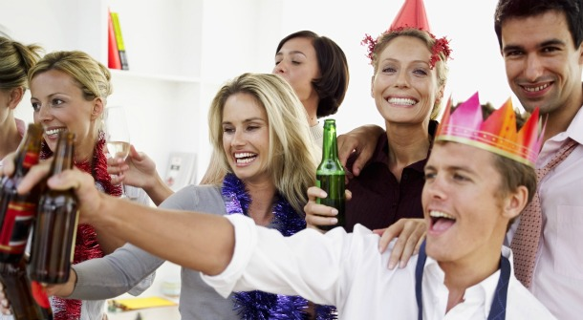
Common Costs
Overtime Air Control
Food Costs
Car Service

Slide 4







Steva To the Rescue!
Employees Interact with Steva Bot if they are going to Work Late
No Need to Have additional administrative staff on hand to handle Working Late Requests
Built on Flint Frame Work
Cisco Spark
Built.io
Tropo
Nest Thermostat – Coming Soon
Uber – Coming Soon
Grubhub – Coming Soon

Slide 5
Steva Bot – Lower Costs
Food Ordering
Approved Restaurants
Set Menus
Direct Contact with the Restaurants
Temperature
Only Three Temperature Settings
Direct Contact with the Building Management
Car Service
Only Approved Car Service
Set Pick Up Location
Transparency to Management
Report of Previous Nights Activity
Hold Employee Accountable for Costs outside of allowed Window

Slide 6

Steva Demo
Moment of Silence for the Demo Gods

Slide 7
Steve Bot
Q & A
Thank you to Presidio & Cisco

